Slide 1
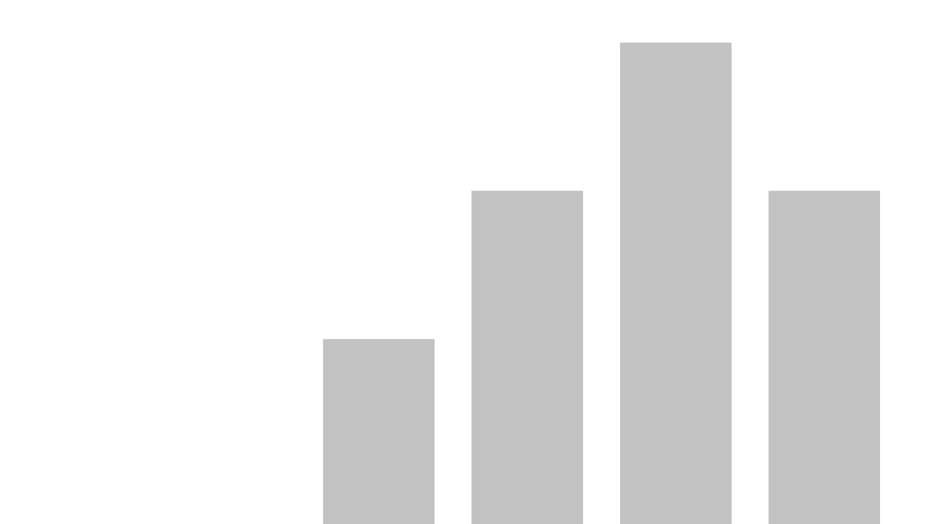


Telecom-Churn-Analysis-Dashboard
View in Power BI
Last data refresh:
2/15/2022 12:05:36 PM UTC
Downloaded at:
2/15/2022 12:16:26 PM UTC

Slide 2
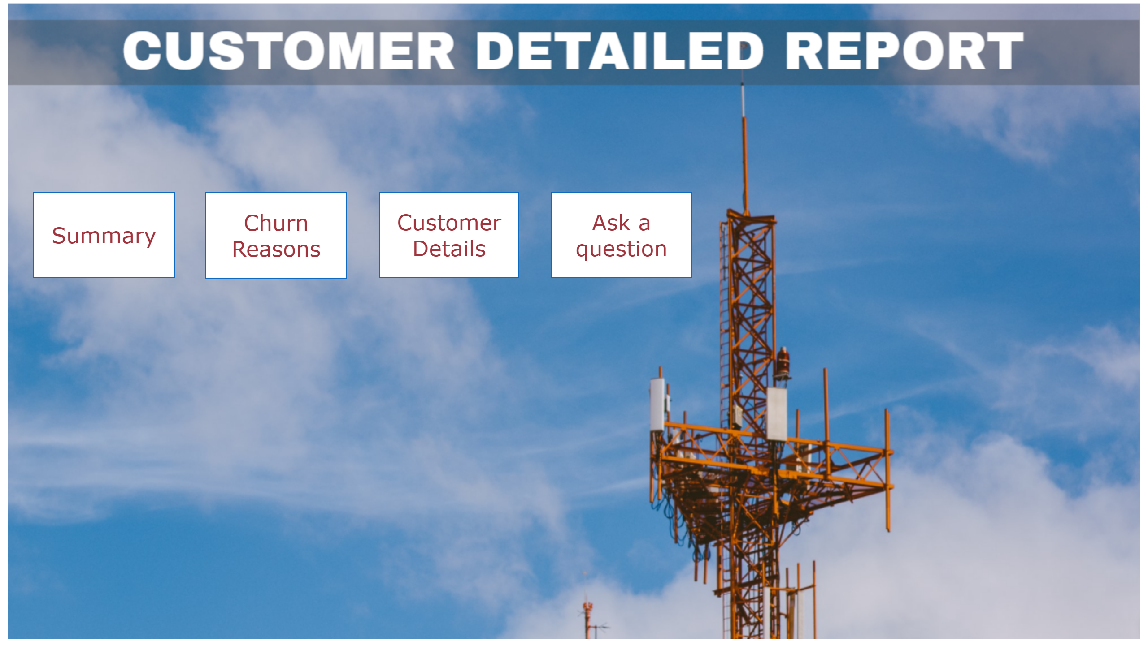
Home
Notes:
shape
No alt text provided
shape
No alt text provided
shape
No alt text provided
shape
No alt text provided

Slide 3
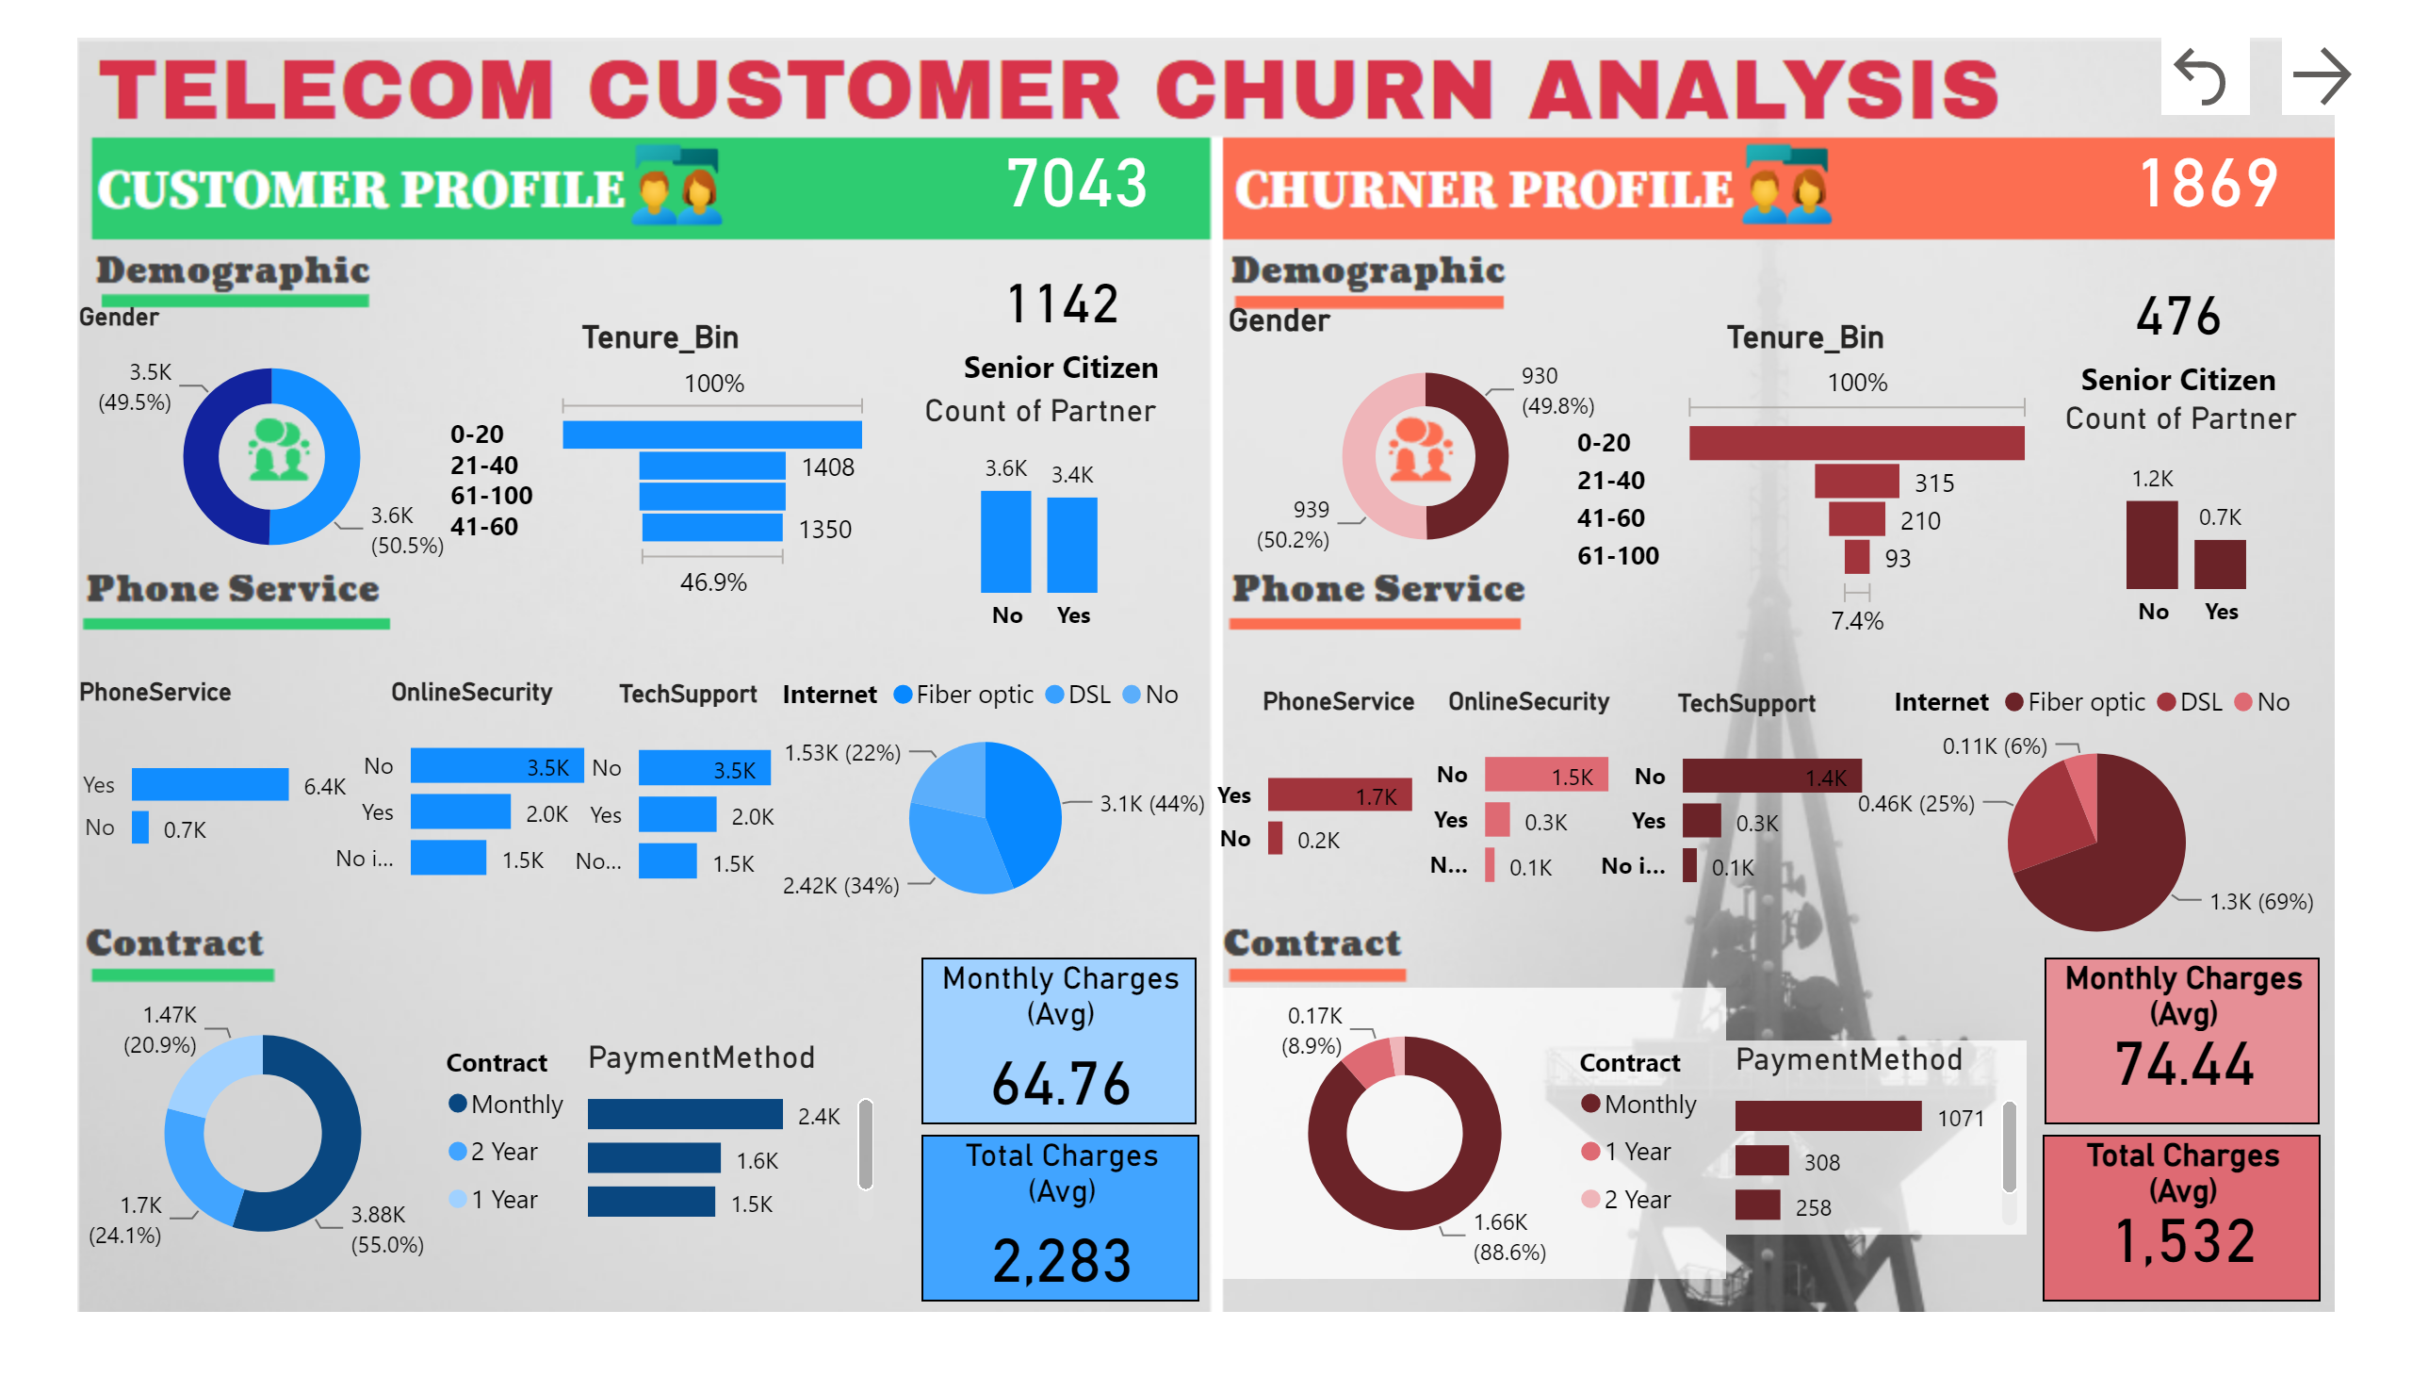
Summary
Notes:
card
No alt text provided
card
No alt text provided
Gender
No alt text provided
Gender
No alt text provided
Tenure_Bin
No alt text provided
Tenure_Bin
No alt text provided
card
No alt text provided
card
No alt text provided
Count of Partner
No alt text provided
Count of Partner
No alt text provided
PhoneService
No alt text provided
PhoneService
No alt text provided
OnlineSecurity
No alt text provided
OnlineSecurity
No alt text provided
TechSupport
No alt text provided
TechSupport
No alt text provided
pieChart
No alt text provided
pieChart
No alt text provided
donutChart
No alt text provided
donutChart
No alt text provided
PaymentMethod
No alt text provided
PaymentMethod
No alt text provided
Monthly Charges (Avg)
No alt text provided
Monthly Charges (Avg)
No alt text provided
Total Charges (Avg)
No alt text provided
Total Charges (Avg)
No alt text provided
actionButton
No alt text provided
actionButton
No alt text provided

Slide 4
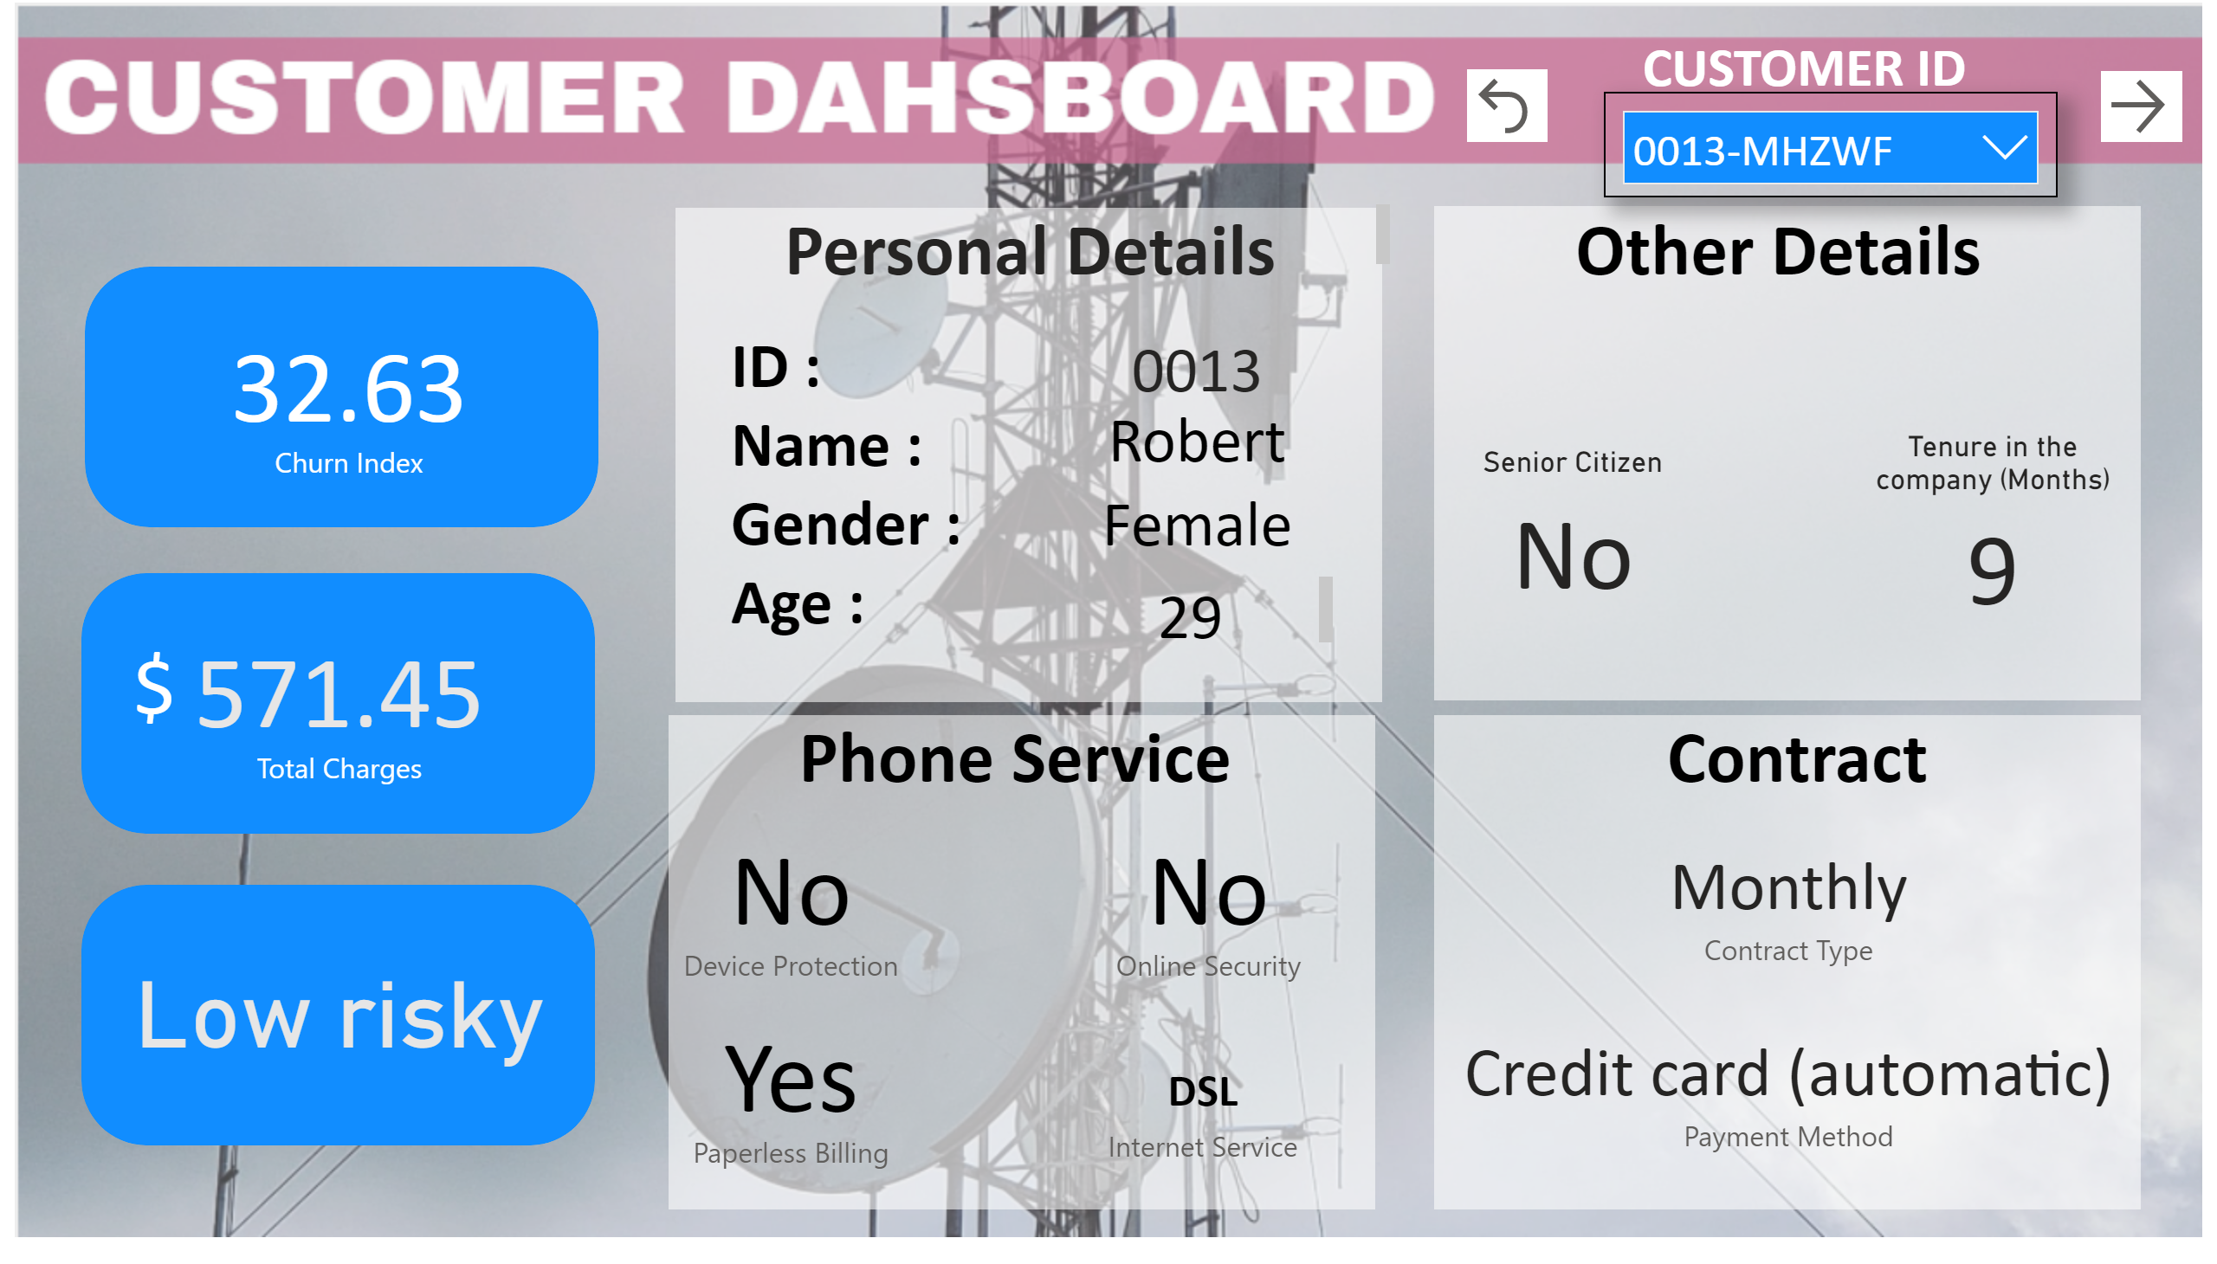
Customer Details
Notes:
shape
No alt text provided
shape
No alt text provided
shape
No alt text provided
shape
No alt text provided
card
No alt text provided
card
No alt text provided
Tenure in the company (Months)
No alt text provided
card
No alt text provided
Senior Citizen
No alt text provided
card
No alt text provided
card
No alt text provided
card
No alt text provided
card
No alt text provided
slicer
No alt text provided
textbox
No alt text provided
textbox
No alt text provided
textbox
No alt text provided
textbox
No alt text provided
textbox
No alt text provided
textbox
No alt text provided
textbox
No alt text provided
card
No alt text provided
shape
No alt text provided
card
No alt text provided
shape
No alt text provided
shape
No alt text provided
card
No alt text provided
card
No alt text provided
textbox
No alt text provided
textbox
No alt text provided
actionButton
No alt text provided
actionButton
No alt text provided

Slide 5
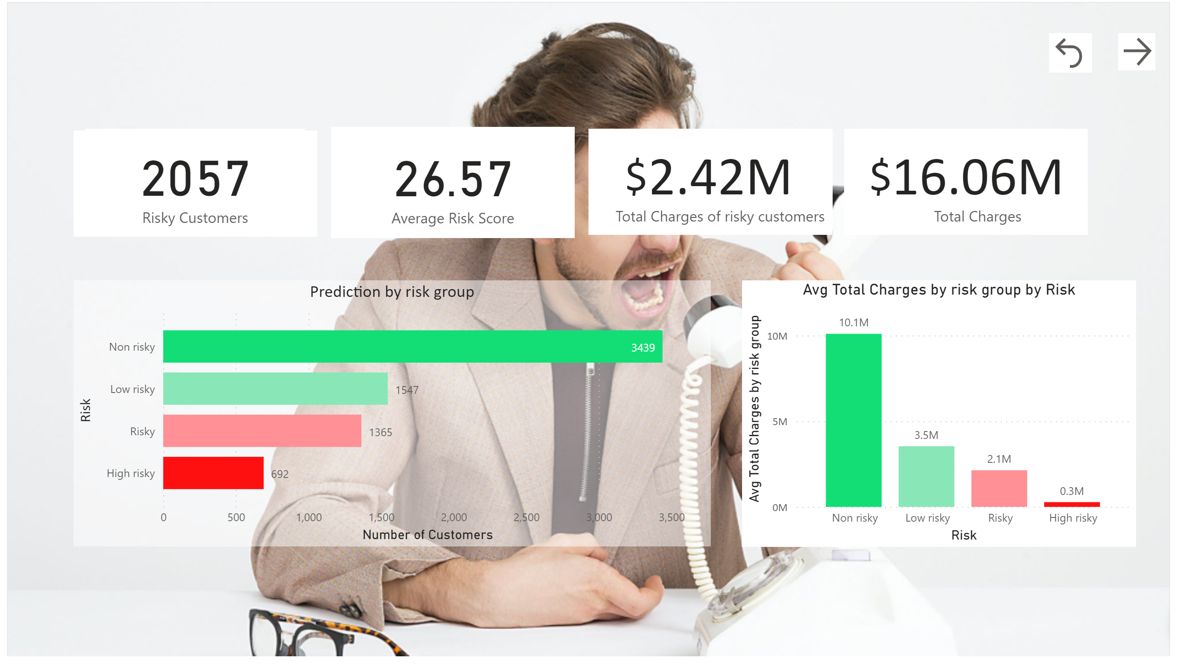
Churn Reasons
Notes:
shape
No alt text provided
Prediction by risk group
No alt text provided
shape
No alt text provided
shape
No alt text provided
shape
No alt text provided
card
No alt text provided
card
No alt text provided
card
No alt text provided
card
No alt text provided
textbox
No alt text provided
textbox
No alt text provided
clusteredColumnChart
No alt text provided
actionButton
No alt text provided
actionButton
No alt text provided

Slide 6
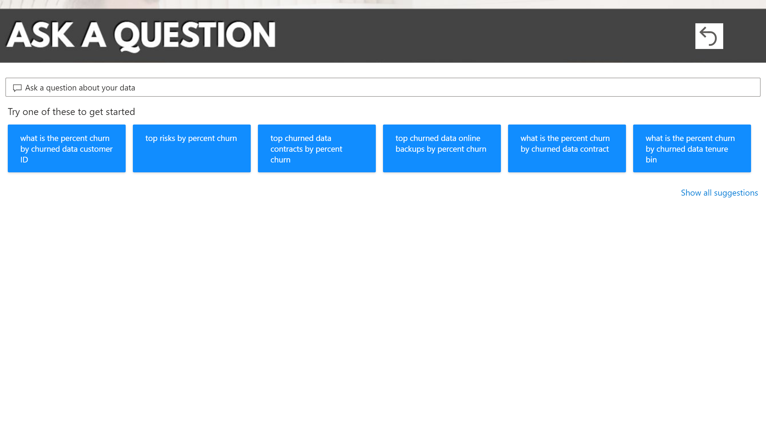
Ask a question
Notes:
qnaVisual
No alt text provided
actionButton
No alt text provided

